Slide 1
Iris Flower Classification
Analyzing Sepal & Petal Features to Classify Iris Species
Shreya Singh | unified Mentor| 11August
Project Link:- Tableau Dashboard

Slide 2
Understanding the Problem
The Iris dataset is a well-known dataset in data science for classification tasks.
Goal: Classify flowers into three species based on measurements.
Helps in understanding classification techniques & visualization.

Slide 3
Project Objective
Explore sepal & petal dimensions for three iris species.
Identify distinguishing patterns between species.
Create a dashboard for quick species comparison.
Demonstrate data visualization and classification analysis.

Slide 4
Techniques Used
Data Cleaning: Handling structure & formatting.
Exploratory Data Analysis (EDA): Using Tableau for visual insights.
Comparative Analysis: Bubble, Pie, Scatter, and Bar charts.
Dashboard Creation: Integrated view with interactive filters

Slide 5
Dataset Description
Source: UCI Machine Learning Repository
Total Records: 150
Features:
Sepal Length (cm)
Sepal Width (cm)
Petal Length (cm)
Petal Width (cm)
Species (Target Variable – Setosa, Versicolor, Virginica)

Slide 6
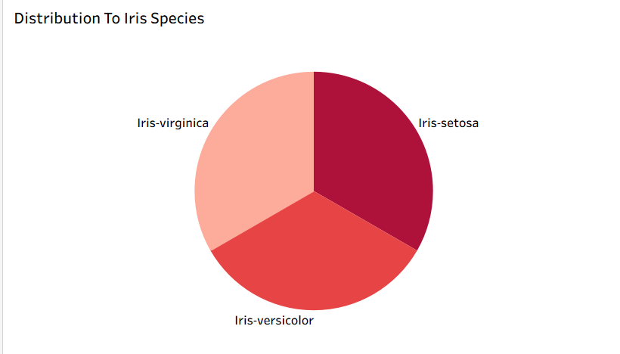
Distribution To Iris Species

Slide 7
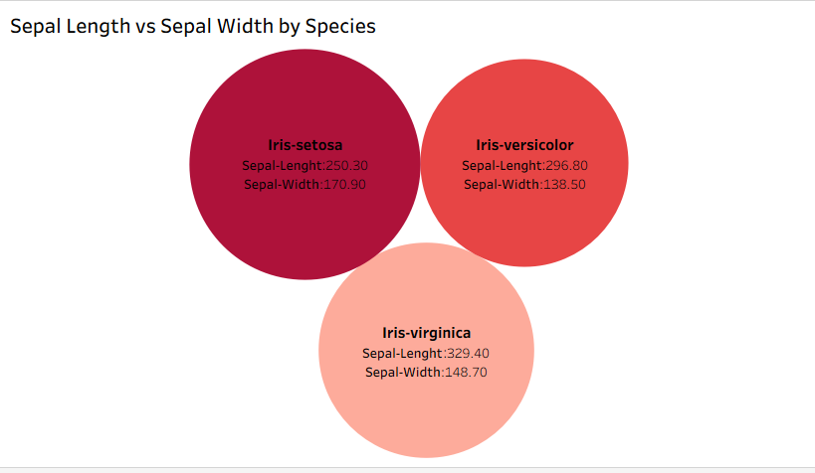
Sepal Length vs Sepal Width by Species

Slide 8
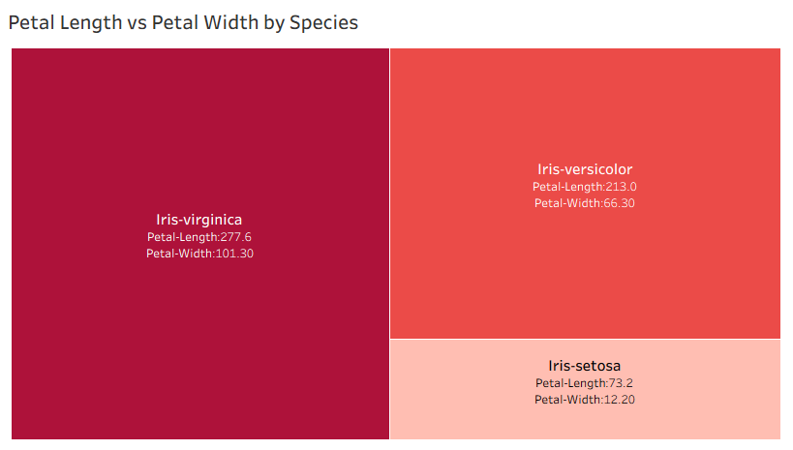
Petal Length vs Petal Width by Species

Slide 9
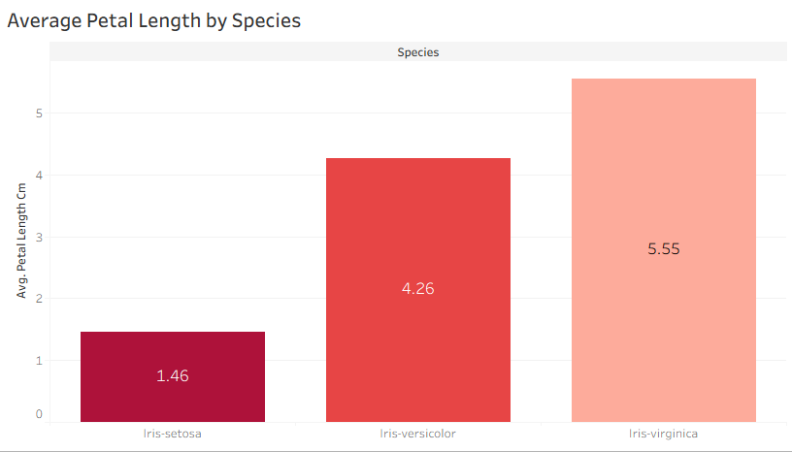
Average Petal Length by Species

Slide 10
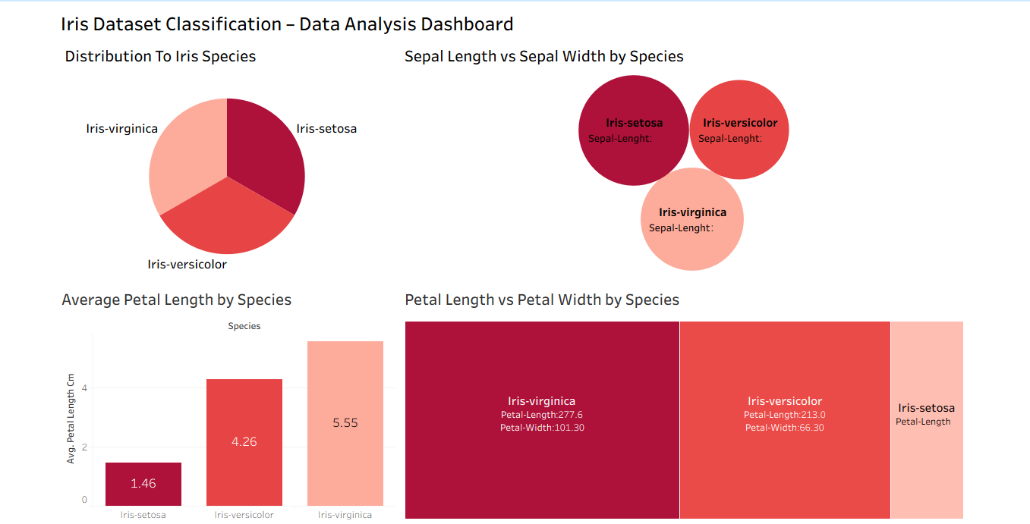
Final Dashboard Output

